Slide 1
FEATURES OF JAVA

Slide 2
What is Java
Java is a programming language and computing platform first released by Sun Microsystems in 1995. It has evolved from humble beginnings to power a large share of today’s digital world, by providing the reliable platform upon which many services and applications are built. New, innovative products and digital services designed for the future continue to rely on Java, as well.

Slide 3
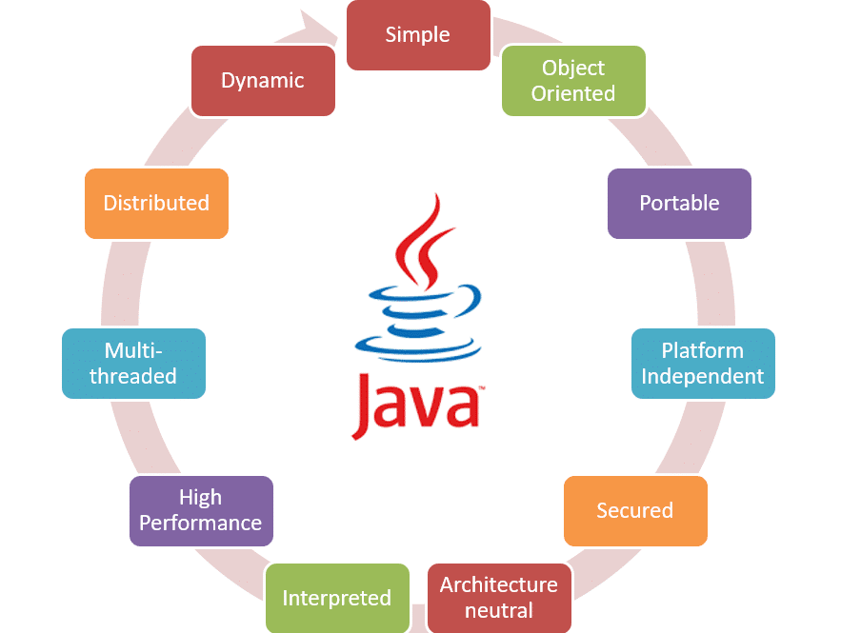
Features of
Java

Slide 4
Simple
Java is Easy to write and more readable and eye catching.
Java has a concise, cohesive set of features that makes it easy to learn and use
Most of the concepts are drew from C++ thus making Java learning simpler

Slide 5
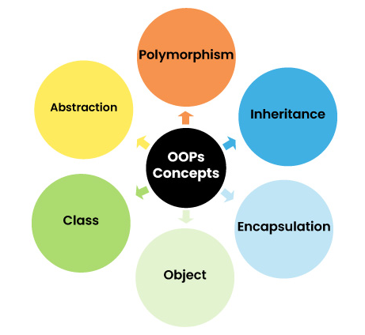
Java is Object-oriented
Java programming is object – oriented programming language.
C++ java provides most of the object oriented features.
Java is pure OPP. Language.

Slide 6
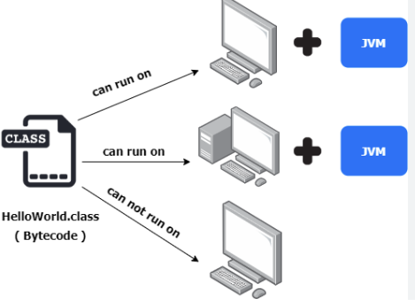
Java is Portable
Java programs can execute in any environment for which there is a Java run-time system.
Java programs can be run on any platform (Linux, Window, Mac)
Java programs can be transferred over world wide wed.

Slide 7
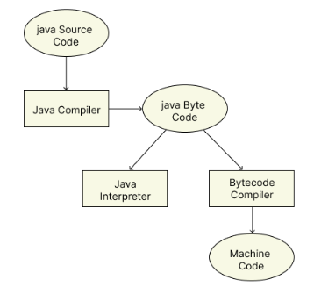
PLATFORM - INDEPENDENT
Java is platform-independent because it uses a "Write Once, Run Anywhere" approach.
Java source code is compiled into bytecode, which is platform-neutral. This bytecode can be executed on any platform that has a Java Machine (JVM) compatible with that bytecode.

Slide 8
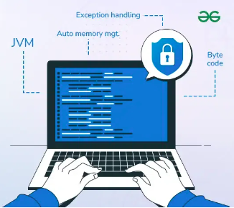
Java is Secure
Java program cannot harm other system thus making it secure.
Java provides a secure means of creating Internet applications.
Java provides secure way to access web applications.

Slide 9
Java is architecture-neutral
Java is not tied to a specific machine or operating system architecture.
Machine Independent i.e. Java is independent of hardware.

Slide 10
Java is interpreted
Java supports cross-platform code through the use of Java bytecode.
Bytecode can be interpreted on any platform by JVM.

Slide 11
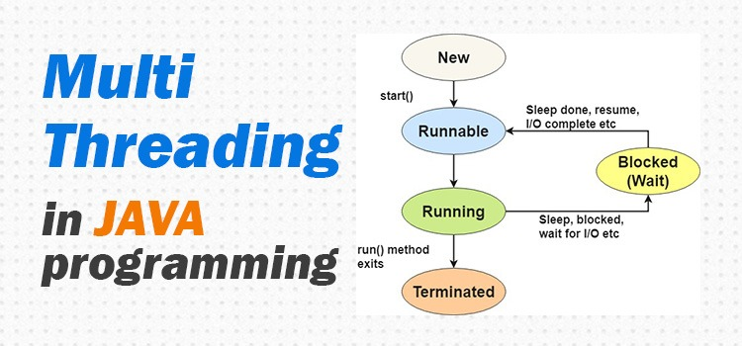
Java’s Performance
Java is Multithreaded
Bytecodes are highly optimized.
JVM can executed them much faster.
Java provides integrated support for multithreaded programming.

Slide 12
Java is distributed
Java is dynamic
Java was designed with the distributed environment.
Java can be transmit, run over internet.
Java programs carry with them substantial amounts of run-time type information that is used to verify resolve accesses to object at run time.

Slide 13
Java is Conclusion
Objects are created with every Java program it is an object oriented programming language, the garbage collector frees the memory from objects which are not required or which will not be required. In order to check whether an object is required or not its recent references are checked.

